Slide 1
Email Spam detection using machine learning
Done by:
Raghu sai k
Sai sri latha k
Pavan charan p
Puneeth t

Slide 2
Introduction
Email or email spam is defined as” the use of email for unsolicited transmission. Automated email filtering is the most effective method It detects spam, but modern spammers can easily bypass all these spam filtering applications. Years ago, most spam emails could be blocked manually from a specific email address. A machine learning approach is used for spam detection.
Filtering is one of the most popular approaches developed to stop spam. important technique. Much spam filter research focuses on more. A challenging classifier-related problem. Machine learning for spam classification has become a major research topic in recent days.
Effectiveness of the proposed work in investigating and identifying the use of various learning algorithms for classifying spam messages from email. These methods are used to classify emails as spam (valid messages) or spam (unwanted messages) using machine learning classifiers. The most common spam detection techniques use Naive Bayes and a set of functions that evaluate the presence of spam keywords.

Slide 3
Spam And Ham
” Ham” This term was coined by Spam Bayes Around 2001, defined as” generally unwanted email.” It is not considered spam.”
Spam is an economically viable type of commercial advertising as email can be a very cheap medium for senders. Spam is usually caused by sharing our email addresses on unauthorized or malicious websites.
Spam has many effects. A bunch of silly emails fills up your inbox. Your internet speed will drop significantly. It steals useful information such as contact list details. Change search results in any computer program. Spam is very time-consuming and can quickly become very frustrating when received in bulk.

Slide 4
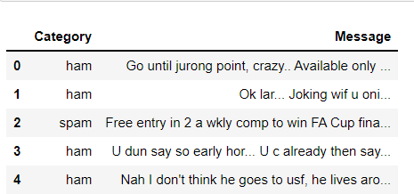
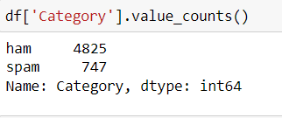
Methodology
We have taken a dataset from the Kaggle website and done some Data Analysis like text transformation, Feature Extraction. As it is a text dataset, in-text transformation, we removed stop words, punctuations, and after done stemming.
After that, uses the NLTK package to create machine-readable text from text sources. readable style. Utilize tokenization for analyzing data. phase. Stem to the last word recovered and remove the stop words, record. Essentially, this is a word processor.
We have downloaded the CSV file of the spam-message dataset. Let us have a look at the dataset we took from Kaggle,

Slide 5
Data Preprocessing
When we look at the data, it’s always a huge dataset with many rows and columns, of news. However, this is not always the case. The data can be in various formats. For example, photos, Audio, video files Structured tables, etc. Machines don’t understand images, videos, or text data, only machines understand the 1’s and 0’s.
Data pre-processing steps:
Data clean-up: This step includes tasks such as entering ’missing values’, ’smoothing noisy data’, ’identifying or removing outliers’, and ’resolving discrepancies.
Data conversion: Aggregation and normalization are executed to scale to a specific value.
Data reduction: This section contains an overview of a minimal data set, but the same analysis results so far.

Slide 6
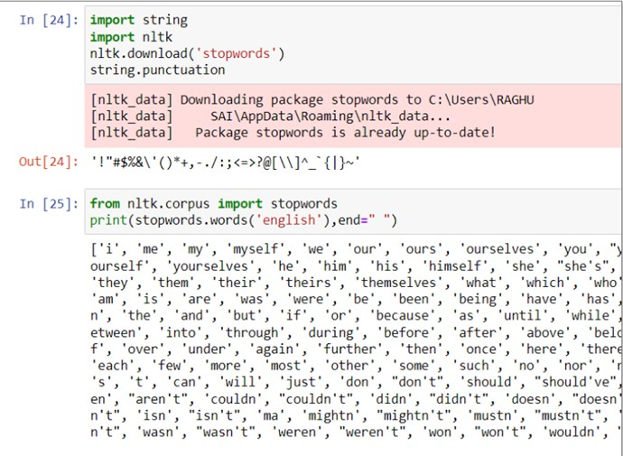
Stop Words Removal
An English word that adds little is referred to as a stop word, giving a sentence meaning. You can disregard it without risk by sacrificing the sentence's intended meaning.

Slide 7
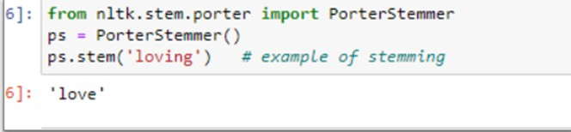
Stemming
Reducing words to their stems is a process called stemming (prefixes, suffixes, or lemma-like stems) Stemming is crucial for natural language comprehension (NLU) and processing language naturally (NLP).

Slide 8
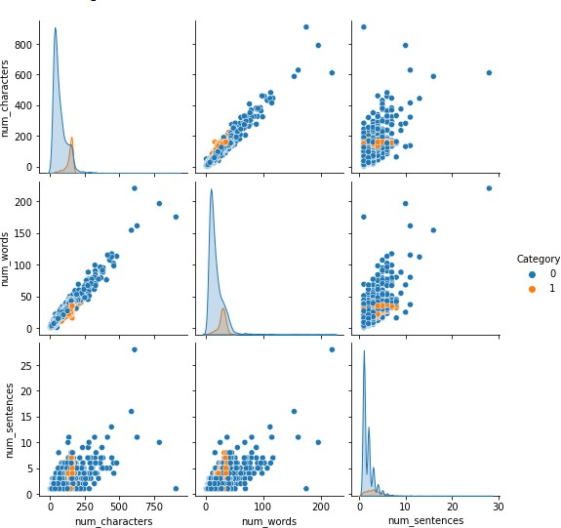
Tokenization
Breaking the flow of texts is what tokenization entails into sentences, glyphs, words, or other expressive components known as tokens.
Due to tokenization, this is on a word-by-word basis. Tokens frequently rely on traditional heuristics. Tokens are separated by spaces, for instance, punctuation, including "new lines" and "spaces." Each A token consists of an alphabetical string that is repeated. equal to numbers. Punctuation and spaces may or may not be used. the token list that results.
Here are some of the results of using tokenization

Slide 9
TF-IDF Vectorizor
TFIDF works by proportionally increasing the frequency with which a word appears in a document, which is then balanced by the frequency with which the word appears in the total number of documents. Calculate
Tf -IDF (term frequency-inverse document frequency).
Term Frequency (TF) tracks how frequently a term appears in a document.

Slide 10
Naive Bayes Approach
We choose the GaussianNB classifier for the Naive Bayes, Bernoulli, and MultinomialNB models/algorithms. As previously stated, we will perform data analysis using the NLTK package.
The dataset has been cleaned and converted to text. even though there are several no.of approaches How to determine whether an email is spam. I employed a naive Bayes method. The components of a naïve Bayes Classifier are using Bayesian theorem-based classification methods.

Slide 11
Bayes Therom
The Bayes theorem can be used to determine the likelihood that A will take place now that B has happened. where B is proof and A is a supposition. Here, it is assumed that The predictors and characteristics are separate. Meaning, the existence of Other attributes is unaffected by a particular trait. Thus, it is known as naïve.
P(A|B) = P(B|A)*P(A) / P(B)

Slide 12
Gaussian NB
When it is assumed that all continuous variables connected to each feature are distributed randomly, Gaussian Naive Bayes is utilized. A normal distribution is another name for a gaussian distribution.

Slide 13

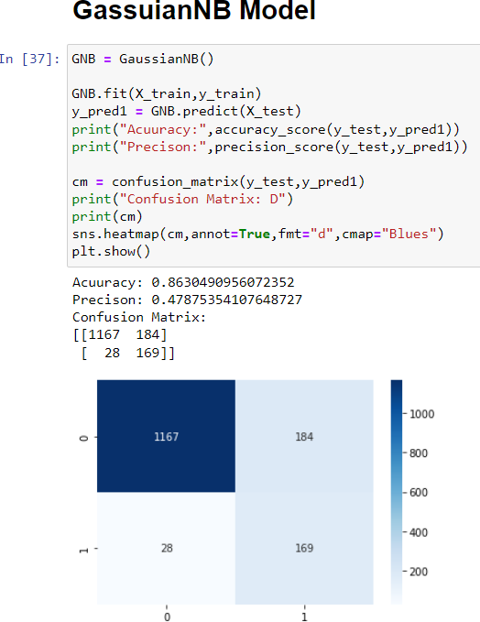
Implementation of Gaussian NB
Gaussian Naive Bayes implementation on the training set. The outcome of applying the Gaussian NB classifier to the transformed text
 | Precision | Recall | F1 score | support
Ham | 0.98 | 0.86 | 0.92 | 1351
Spam | 0.48 | 0.86 | 0.61 | 197
accuracy |  |  | 0.86 | 1548
macro avg | 0.73 | 0.86 | 0.77 | 1548
weighted avg | 0.91 | 0.86 | 0.88 | 1548

Slide 14
Multinomial NB
Multinomial Naive Bayes, For classification based on separate features (such as word counts for text classification), Bayes classifiers work well. In general, integer numbers of features are needed for multinomial distributions. However, in actuality, decimals like TF-IDF also function.

Slide 15
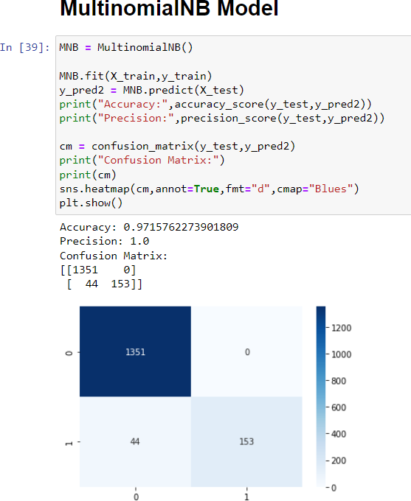
Implementation of Multinomial NB
Naive Bayes implementation on the training set. The outcome of applying the Multinomial NB classifier to the transformed text
 | Precision | Recall | F1 score | support
Ham | 0.97 | 1.00 | 0.98 | 1351
Spam | 1.00 | 0.78 | 197 | 197
accuracy |  |  | 0.97 | 1548
macro avg | 0.98 | 0.89 | 0.93 | 1548
weighted avg | 0.97 | 0.97 | 0.97 | 1548

Slide 16
Bernoulli NB
Bernoulli Naive Bayes is part of the Naive Bayes family, Accepts only binary values. Checking to see if each value is a word that appears in a document is the most typical example. This is a fairly straightforward model.

Slide 17
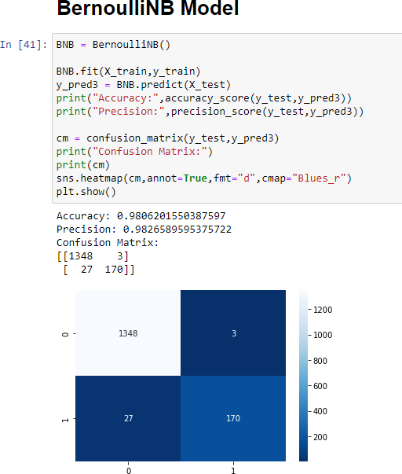
Implementation of Bernoulli NB
Naive Bayes implementation on the training set. The outcome of applying the Bernoulli NB classifier to the transformed text
 | Precision | Recall | F1 score | support
Ham | 0.98 | 1.00 | 0.99 | 1351
Spam | 0.98 | 0.86 | 0.92 | 197
accuracy |  |  | 0.98 | 1548
macro avg | 0.98 | 0.93 | 0.95 | 1548
weighted avg | 0.98 | 0.98 | 0.98 | 1548

Slide 18
Logistic Regression Approach
Logistic Regression is a subset of the Generalized Linear Model algorithm class. Logistic regression is a statistical technique for predicting binary outcomes. Based on previous observations of the dataset, yes or no.
Implementation of Logistic Regression
Implementation on the training set. The outcome of applying the Logistic Regression Linear classifier to the transformed text is

Slide 19
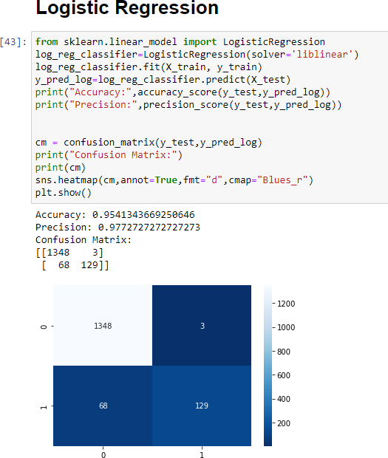
Implementation of Logistic Regression
We obtained a precision of 0.97 and an accuracy of 0.95. We can see that there are 3 True Negatives and 68 False Positives from the confusion matrix above.
 | Precision | Recall | F1 score | support
Ham | 0.95 | 1.00 | 0.97 | 1351
Spam | 0.98 | 0.65 | 0.78 | 197
accuracy |  |  | 0.95 | 1548
macro avg | 0.96 | 0.83 | 0.88 | 1548
weighted avg | 0.96 | 0.95 | 0.95 | 1548

Slide 20
Convolutional Neural Networks [CNN]
Convolutional neural networks (CNN/ConvNet) are the most widely employed class of deep neural networks in deep learning for the analysis of visual images. Matrix multiplication comes to mind when we think of neural networks.
We will construct a CNN model and train it using the train set.
Implementation of CNN Model
CNN implementation on the training set. The outcome of applying the CNN model to the transformed text is:

Slide 21
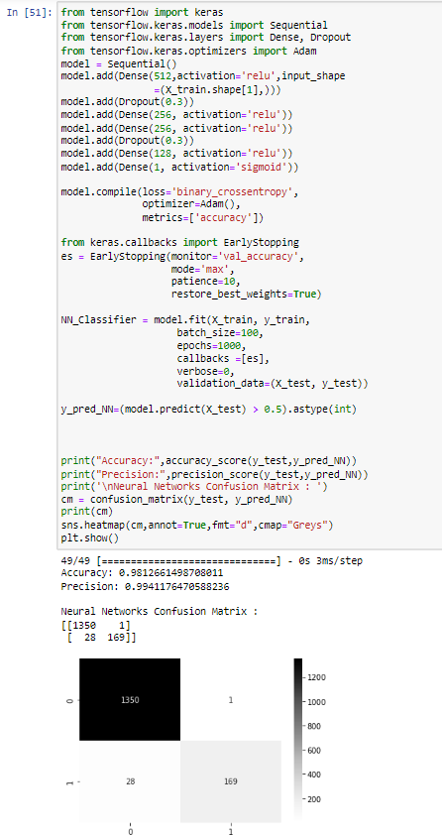
Implementation of CNN
We obtained a precision of 0.98 and an accuracy of 0.99. We can see that there are 1 True Negatives and 68 False Positives from the confusion matrix above.
 | Precision | Recall | F1 score | support
Ham | 0.98 | 1.00 | 0.99 | 1351
Spam | 0.99 | 0.86 | 0.92 | 197
accuracy |  |  | 0.98 | 1548
macro avg | 0.99 | 0.93 | 0.96 | 1548
weighted avg | 0.98 | 0.98 | 0.98 | 1548

Slide 22
Comparing Results Of Naive Bayes Classifiers
On the training set, we have thus far utilised Gaussian NB, Multinomial NB, and Bernoulli NB classifiers, and the results are shown as a confusion matrix. Let's examine the results to determine which Naive Bayes classifier is more reliable at detecting spam.
We have used pandas to construct a data frame that details the precision and accuracy of various models. Later, the seaborn library is used to represent graphs.

Slide 23
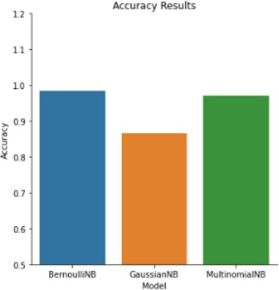
Model Accuracy Precision
The same analysis is represented in the graph below, where models are taken on the x-axis, and their accuracy is scaled on the y-axis
.
0 | Gaussian NB | 0.86 | 0.47
1 | Multinomial NB | 0.97 | 1.0
2 | Bernoulli NB | 0.98 | 0.98
Results of NB Classifiers
Comparison of Results of Naive Bayes

Slide 24
Model Results Comparison
So far we have used Naive Bayes classifiers –
Gaussian NB,
Multinomial NB,
Bernoulli NB
Generalized Linear Classifier - Logistic Regression;
Convolutional Neural Networks - CNN.

Slide 25
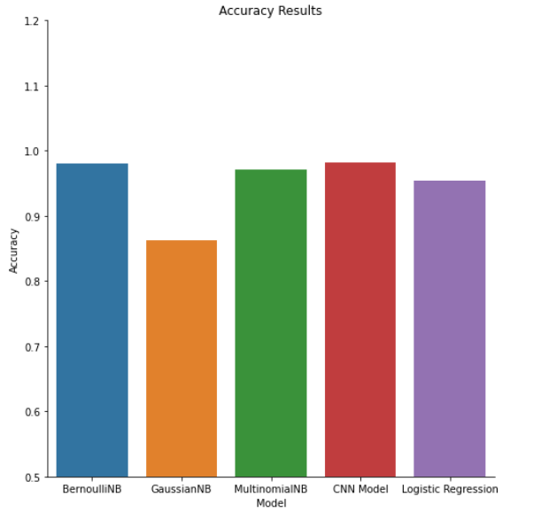
Models Comparison
Below are the comparison results of every model
 | Model | Accuracy | Precision
0 | Gaussian NB | 0.86 | 0.47
1 | Multinomial NB | 0.97 | 1.0
2 | Bernoulli NB | 0.98 | 0.98
3 | Logistic regression | 0.95 | 0.96
4 | CNN | 0.98 | 0.98

Slide 26
THANK YOU

